Slide 1
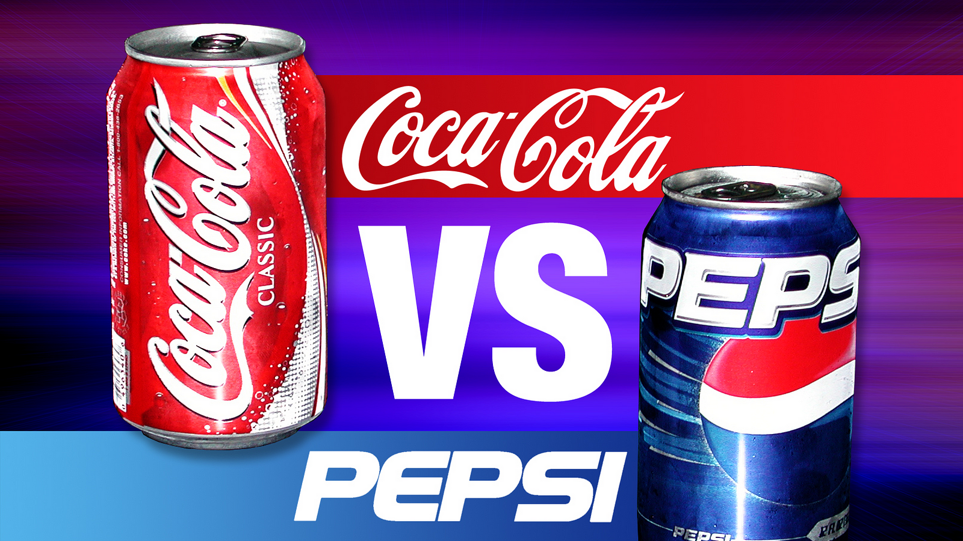
By: Nicholas Ricci, Daniel Phelps, and Michael Willman

Slide 2
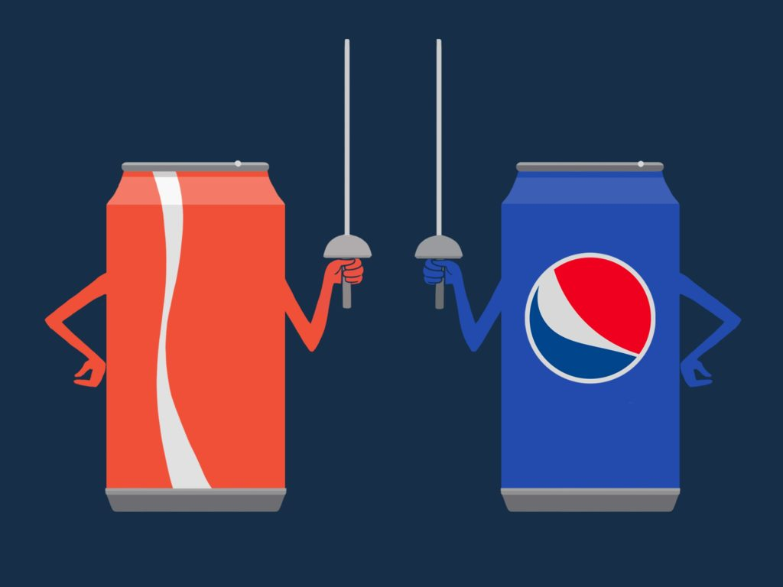
Executive Summary
On December 4, 2000, PepsiCo, Inc., and the Quaker Oats Company announced their merger, with PepsiCo acquiring Quaker Oats in a stock-for-stock deal valuing Quaker at around $14 billion.
The acquisition gave PepsiCo access to Gatorade and control of 83.6% of the sports drink market, consolidating its lead in the noncarbonated-beverages segment.
Analysts estimated that PepsiCo would control around 33% of the U.S. noncarbonated-beverage market after the Gatorade acquisition, far ahead of Coca-Cola's 21%.
Coca-Cola had recently run into difficulties due to various reasons including business mistakes by Doug Ivester, CEO from 1997 to 1999, while PepsiCo had invigorated management.
PepsiCo's acquisition of Quaker Oats gave them control of the sports drink market and further consolidated their lead in the noncarbonated-beverages segment.
After Douglas Daft became the new head of Coca-Cola, major changes were made to the company to help get it back on track.

Slide 3
Overview of the History of Coca-Cola
1993 to 1996
Coca-Cola had consistently ranked first or second in Fortune's annual ranking of the top wealth creators, largely due to its strategy of spinning off its bottling operations to avoid consolidation on its balance sheet.
1997 to 1999
Coca-Cola had recently run into difficulties due to various reasons including business mistakes by Doug Ivester, CEO from 1997 to 1999.
2000
Coca-Cola was making annual sales that were approximately $20.5 billion.
The company’s market value reached approximately $110.1 billion.
Ivester had been eased out and Douglas Daft became the new head of Coca-Cola.
Coca-Cola’s Dasani brand did not enter the market until 1999.
Coca-Cola was consistently doing better than Pepsi-Co during this period.

Slide 4
Overview of the History of PepsiCo
1993 to 1996
PepsiCo test-marketed Aquafina as early as 1994
1997 to 1999
PepsiCo started to realize its strengths and what to produce more of.
2000
Aquafina was the number one ranked bottled-water brand in the U.S. market in 2000.
During Enrico's term, PepsiCo's return on equity almost doubled and reached roughly 30% in 2000.
PepsiCo, in alliance with Starbucks, introduced the highly popular Starbucks Frappuccino in 1996
Positioning PepsiCo as a focused snack and beverage company in 2000 was mostly due to the bottling process that was done by the CEO from 1997, Enrico.
December 4, 2000, PepsiCo, Inc., and the Quaker Oats Company announced their merger, with PepsiCo acquiring Quaker Oats in a stock-for-stock deal valuing Quaker at around $14 billion.
In 2000, PepsiCo, Inc., was a $20 billion company involved in the snack food, soft drink and noncarbonated beverage businesses.

Slide 5
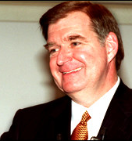
Coca-Cola 1st CEO: Doug Ivester
Known For:
Missing major opportunities to steer the company in the right direction.
Ruining the financial stability of the company.
Notable Management Decisions:
Instituting a 7.7% price hike on syrup
Aggravating the difficulties that Coca-Cola faced due to external factors
Insisting on pushing Coca-Cola's core soft-drink brands.

Slide 6
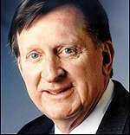
Coca-Cola 2nd CEO: Douglas Daft
Known For:
Steering Coca-Cola back in the right direction and making up for the mistakes that the previous CEO committed.
Notable Management Decisions:
Working to come up with new, noncarbonated products.
Repairing the company financially and structurally.
Cutting staff and reducing bureaucracy
Spinning off some bottling operations to restructure and consolidate others

Slide 7
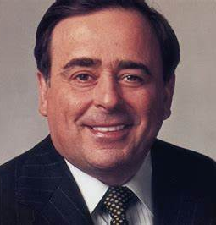
PepsiCo CEO: Roger Enrico
Known For:
Steering the company in the right direction of pursuing the non-carbonated beverage segment.
Notable Management Decisions:
Creating marketing campaigns like the “Joy of Pepsi” campaign to help boost the company’s brand recognition and market share.
Creating an acquisition with Quaker Oats that allowed PepsiCo to control 83.6% of the sports drink market.
Working to expand the PepsiCo noncarbonated-beverage product line.
Investing heavily in power and brand building

Slide 8
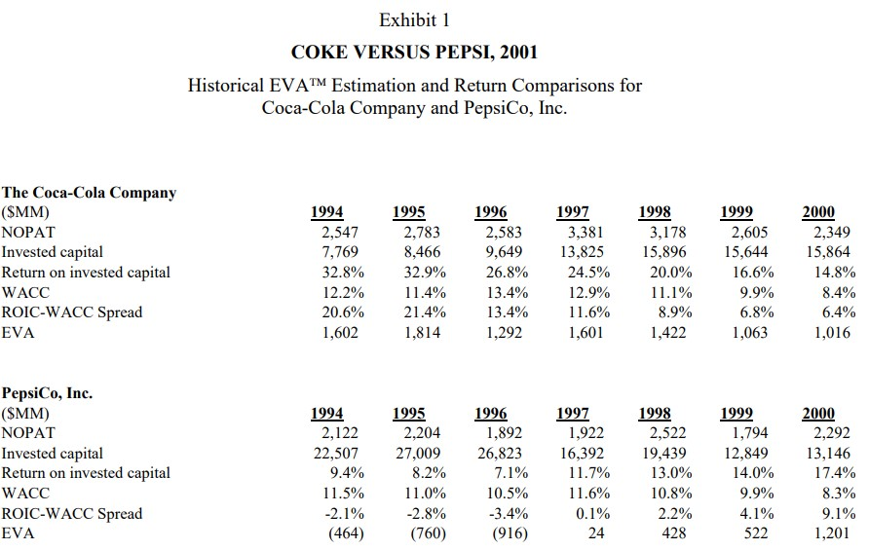

Exhibit 1 Data Analysis
The data compares Coca-Cola Company and PepsiCo, Inc from 1992 to 2001.
It shows the historical EVATM Estimation and Return Comparisons for both companies.
For Coca-Cola Company:
The Return on Invested Capital (ROIC) was generally higher than Weighted Average Cost of Capital (WACC).
The ROIC-WACC spread ranged from 6.4% to 21.4%.
The Economic Value Added (EVA) ranged from 1.063 to 1.602.
For PepsiCo, Inc:
The ROIC was generally higher than WACC.
The ROIC-WACC spread ranged from -2.8% to 22%.
The EVA ranged from -916 to 1,201.
Both companies experienced fluctuations in their financial performance over the years, with some years showing positive EVA and others showing negative EVA.

Slide 9
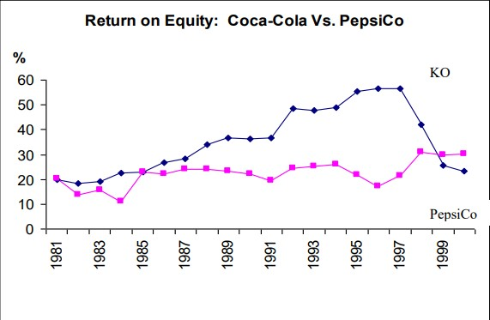
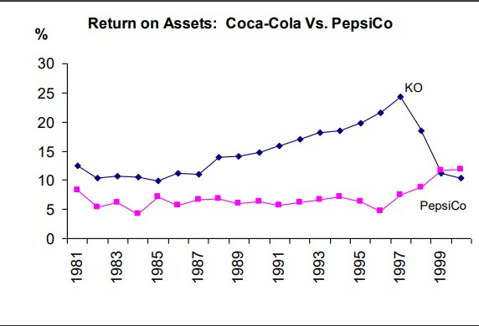
Exhibit 2 Data Analysis
The data compares Coca-Cola and PepsiCo in terms of return on assets (ROA) and return on equity (ROE) from 1981 to 1999.
Both companies experienced a decline in ROA and ROE in the early 1980s, followed by a period of growth until the late 1990s.
Coca-Cola had higher ROA and ROE than PepsiCo throughout most of the 1980s and early 1990s.
PepsiCo's ROA and ROE surpassed Coca-Cola's in the mid-1990s and continued to rise until the end of the period examined.
The difference between the two companies' ROA and ROE narrowed in the late 1990s, but PepsiCo remained ahead of Coca-Cola in both measures.
Overall, PepsiCo performed better than Coca-Cola in terms of ROA and ROE during the period examined.

Slide 10
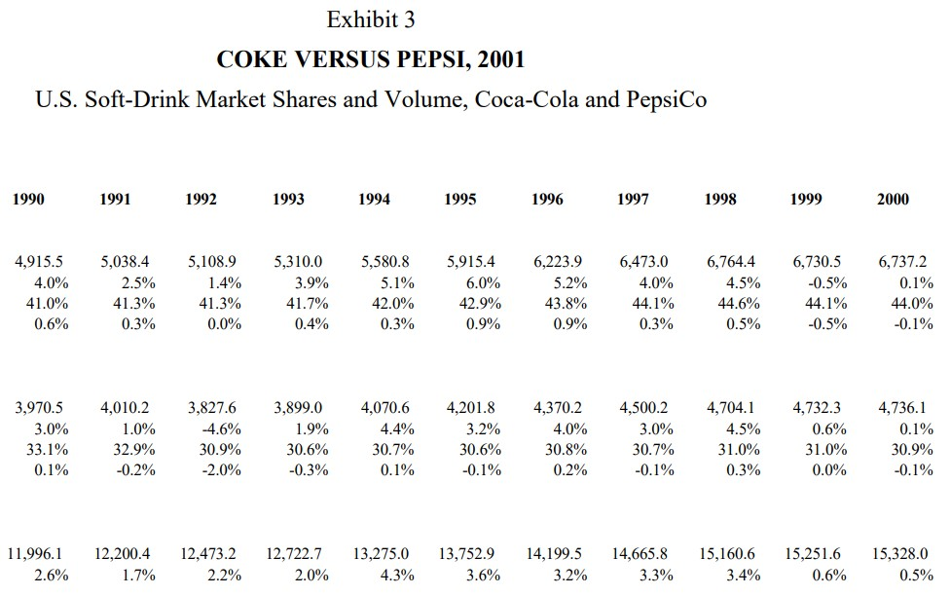
Exhibit 3 Data Analysis
Exhibit 3 shows the market shares and volume of Coca-Cola and PepsiCo in the soft-drink market from 1990 to 2000.
The total soft-drink market volume increased from 11,996.1 million in 1990 to 15,328.0 million in 2000.
Coca-Cola had a higher market share than PepsiCo throughout the period.
Both Coca-Cola and PepsiCo increased their market shares from 1990 to 1995, with Coca-Cola's share ranging from 4.0% to 6.0% and PepsiCo's share ranging from 33.1% to 42.9%.
From 1995 to 2000, Coca-Cola's market share remained relatively stable, while PepsiCo's market share fluctuated between 30.6% and 31.0%.
Despite fluctuations in market share, both Coca-Cola and PepsiCo experienced growth in volume from 1990 to 2000.
Exhibit 3 Key:
1st row: Gallonage (in millions)
2nd row: Growth
3rd row: Market Share
4th row: Market Share Gain/(Loss)
Upper chunk: Coke
Middle chunk: Pepsi
Lower chunk: Soft drink industry

Slide 11
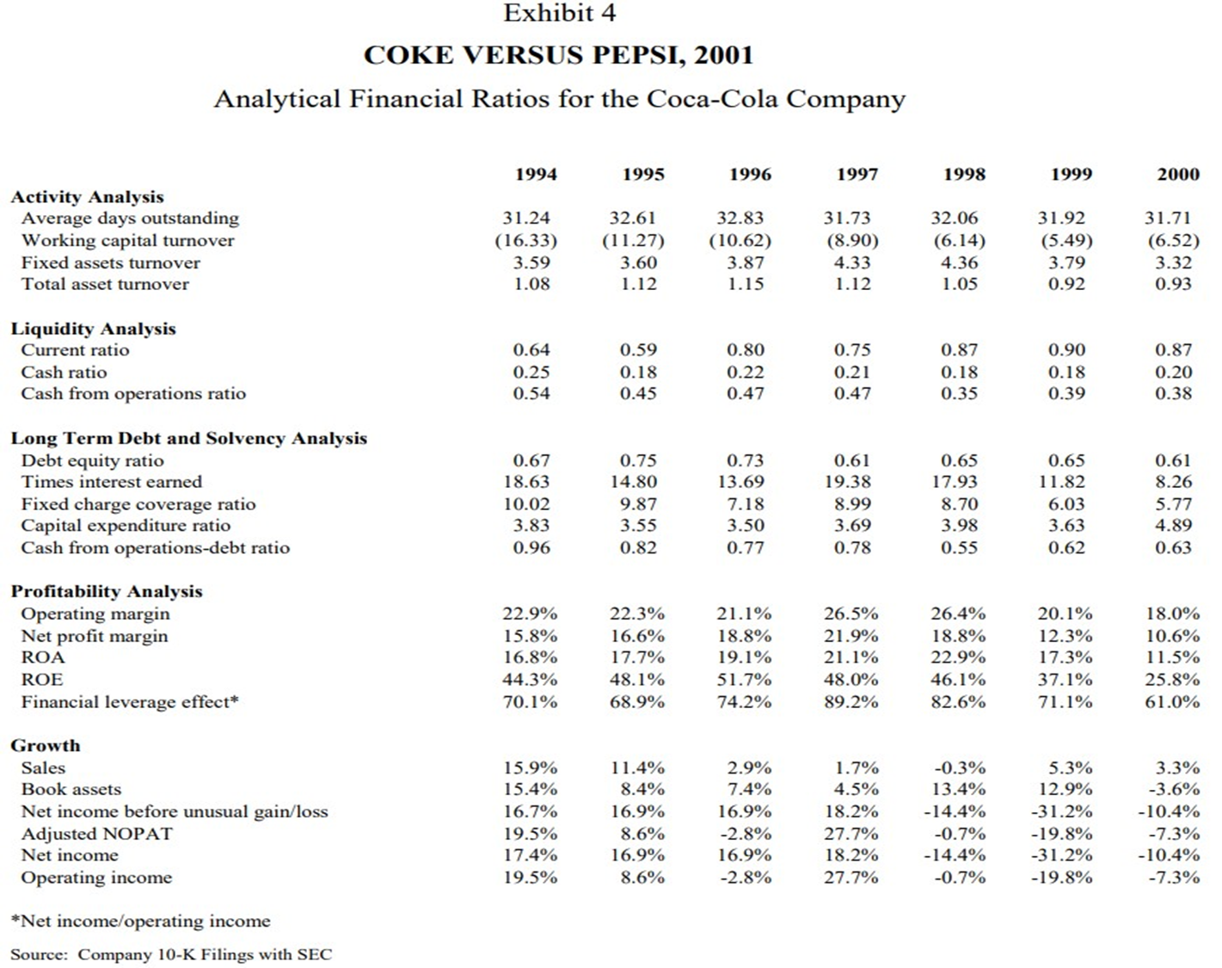
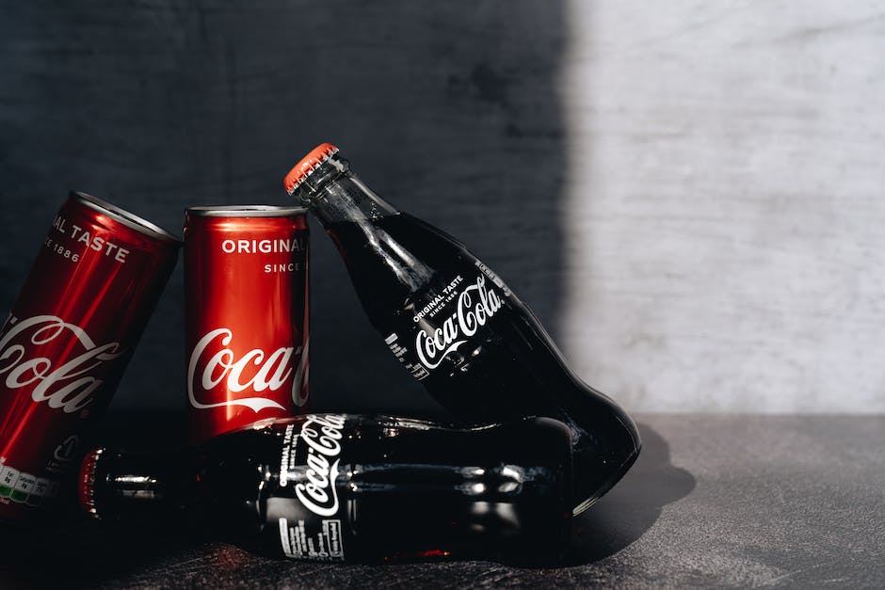
Exhibit 4 Data Analysis
Exhibit 4 provides financial ratios and growth data for Coke vs Pepsi in 2001.
Activity analysis shows that Coke had lower average days outstanding and higher fixed asset and total asset turnover than Pepsi.
Liquidity analysis shows that Pepsi had a higher current and cash ratio than Coke, but Coke had a higher cash from operations ratio.
Long-term debt and solvency analysis shows that Coke had a lower debt-equity ratio and higher times interest earned and fixed charge coverage ratio than Pepsi.
Profitability analysis shows that Coke had higher operating margin, net profit margin, ROA, and ROE than Pepsi.
Growth analysis shows that both companies had positive sales growth, but Pepsi had negative growth in net income before unusual gain loss and adjusted NOPAT.

Slide 12
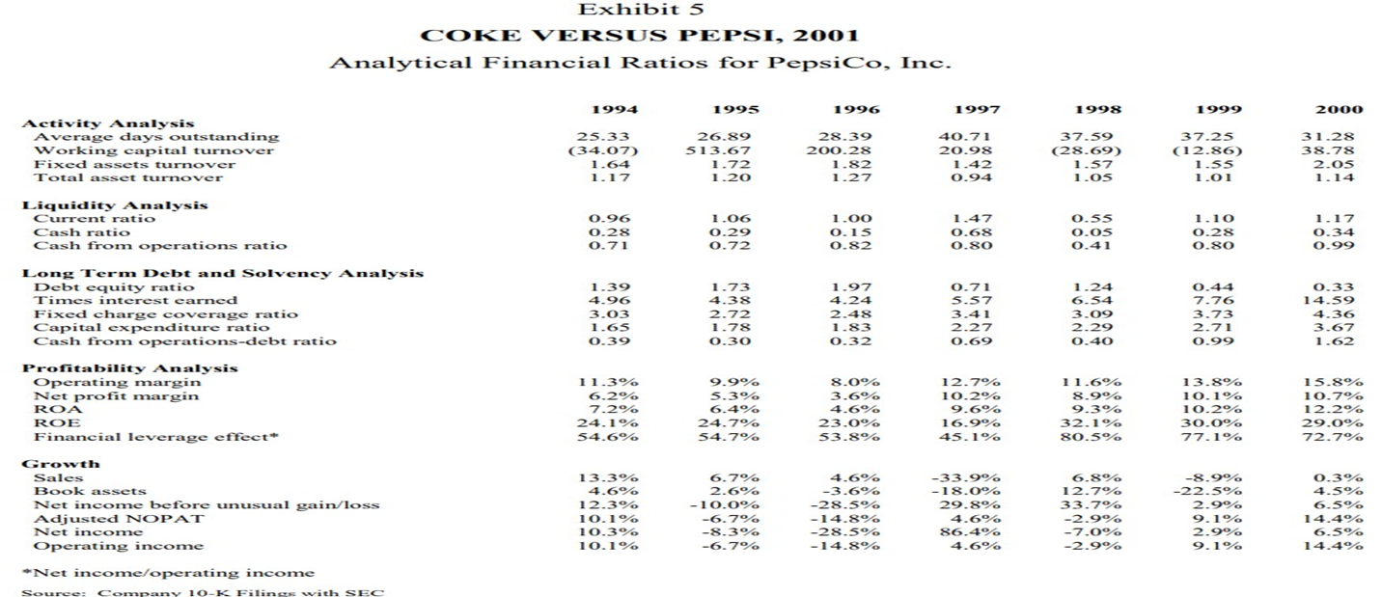

Exhibit 5 Data Analysis
Exhibit 5 shows financial ratios for PepsiCo from 1994 to 2000
Activity analysis shows mixed results for PepsiCo's average days outstanding and asset turnover
Liquidity analysis shows a decreasing trend in PepsiCo's current ratio and cash ratio over the years
Long-term debt and solvency analysis shows a decreasing trend in PepsiCo's debt equity ratio and an increasing trend in its capital expenditure ratio
Profitability analysis shows an increasing trend in PepsiCo's ROA and ROE, along with an increasing trend in financial leverage effect
Growth analysis shows a mixed trend in PepsiCo's sales and net income, with fluctuations in adjusted NOPAT and operating income.

Slide 13
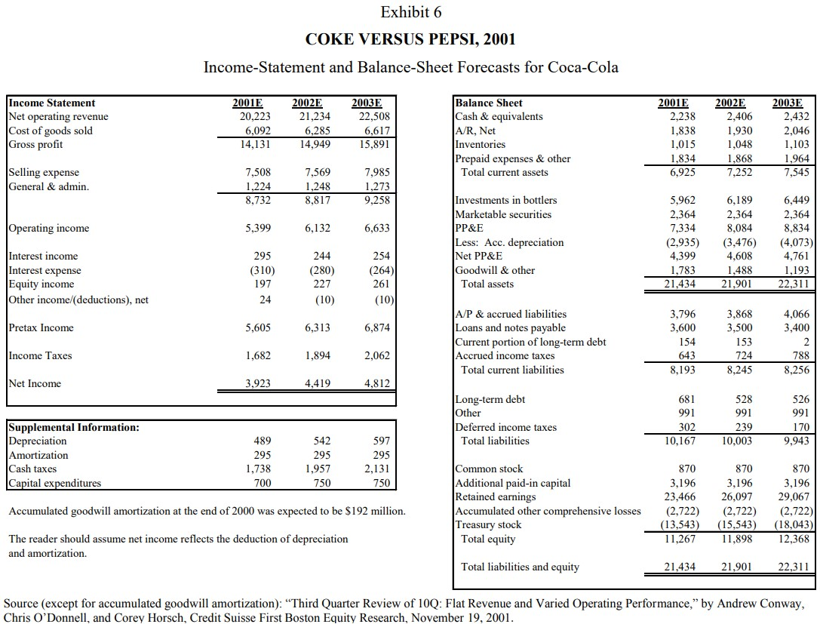
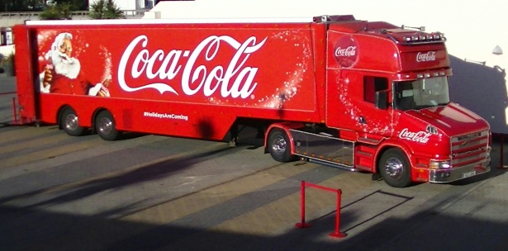
Exhibit 6 Data Analysis
Exhibit 6 presents income statement and balance sheet forecasts for Coca-Cola for three years: 2001, 2002, and 2003.
Net operating revenue is expected to increase each year, from $20.223 billion in 2001 to $22.508 billion in 2003.
Gross profit is also expected to increase each year, from $14.131 billion in 2001 to $15.991 billion in 2003.
Selling expense and general and administrative expense are both expected to increase each year.
Investments in bottlers, marketable securities, and PP&E are all expected to increase each year.
Net income is expected to increase each year, from $1.923 billion in 2001 to $1.812 billion in 2003.
The balance sheet shows that cash and equivalents, AR, and inventory are all expected to increase each year, while prepaid expenses and other are expected to decrease.
Total liabilities and equity are expected to increase each year, from $21.434 billion in 2001 to $22.311 billion in 2003.
Depreciation, amortization, cash taxes, and capital expenditures are all provided as supplemental information.

Slide 14
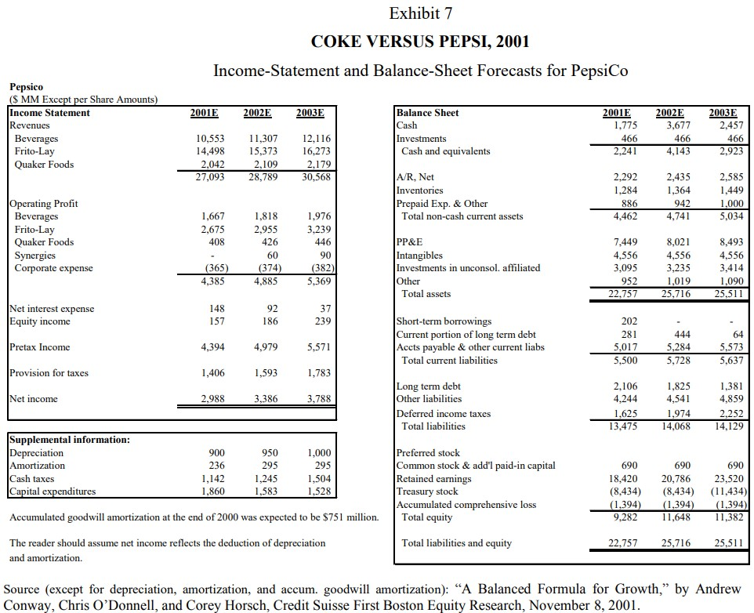
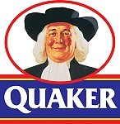
Exhibit 7 Data Analysis
Exhibit 7 presents financial data for PepsiCo and Coke in 2001
The income statement shows revenues for beverages, Frito-Lay, and Quaker Foods
PepsiCo's operating profit is broken down by segment and includes synergies and corporate expenses
The balance sheet includes information on cash, investments, AR, inventories, and other assets
Total assets, liabilities, and equity are provided
Net income and provision for taxes are also reported
Depreciation, amortization, cash taxes, and capital expenditures are presented as supplemental information
The end of 2000 had an accumulated goodwill amortization of $751 million

Slide 15
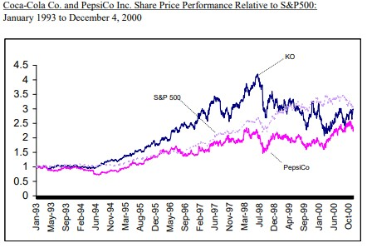

Exhibit 8 Data Analysis
Exhibit 8 compares the share price performance of Coca-Cola Co. and PepsiCo Inc. relative to S&P 500 from January 1993 to December 2000.
The exhibit includes a graph of the share price performance of both companies and the S&P 500 index.
The exhibit also includes the current yields on U.S. Treasuries with various maturities ranging from 3-month to 20-year.
Historical equity risk premiums (1926-1999) are provided, with the geometric mean at 5.90% and arithmetic mean at 7.50%.

Slide 16
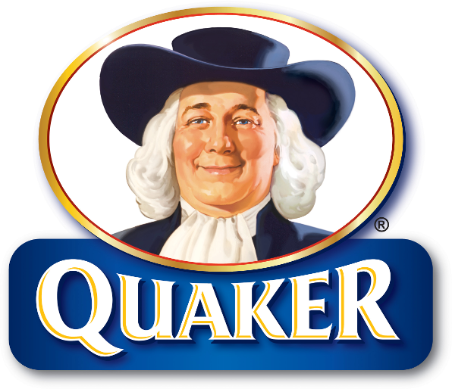
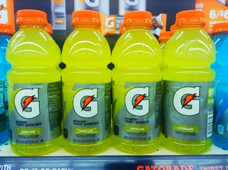
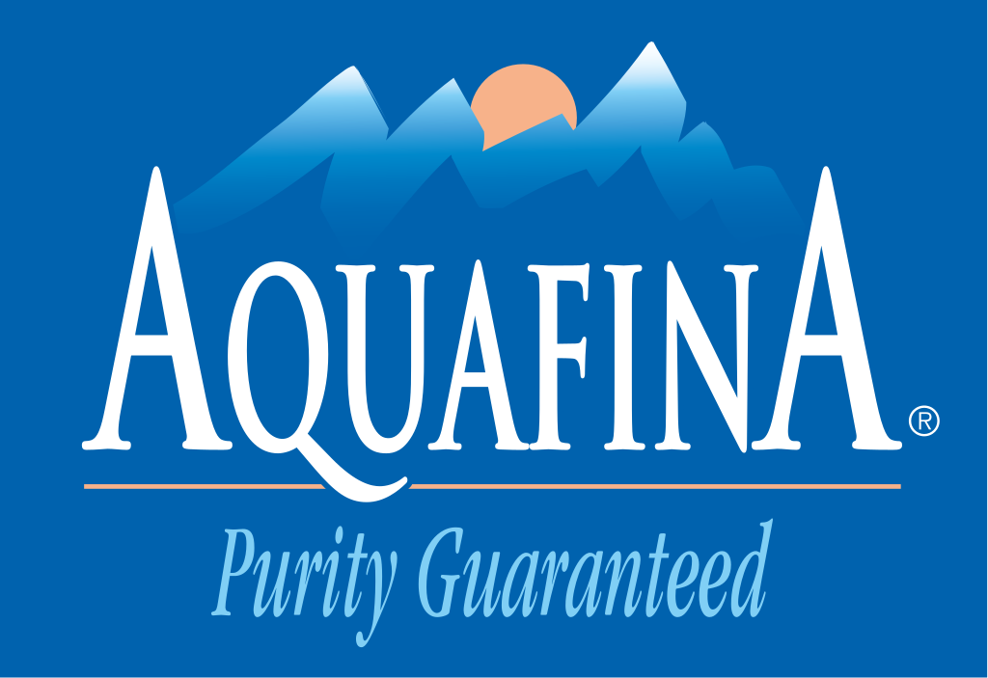
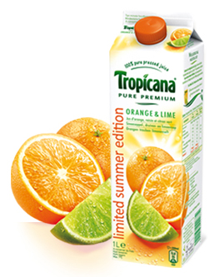
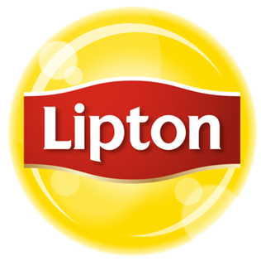
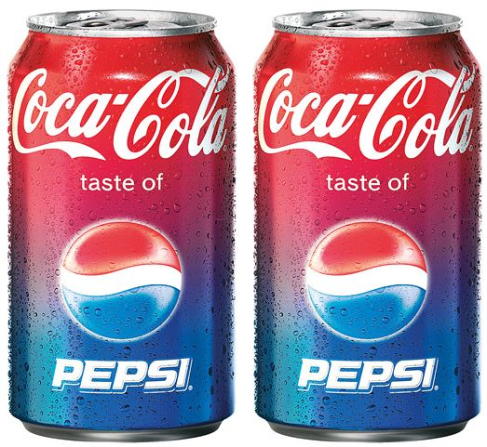
What was the beverage industry trend in 2000? How are two companies doing in the noncarbonated beverages market so far?
In 2000, the beverage industry trend was shifting towards noncarbonated beverages. PepsiCo's acquisition of Quaker Oats, including Gatorade, consolidated its lead in the noncarbonated-beverage market.
Coca-Cola faced difficulties in becoming a dominant player in the noncarbonated-beverage market.
PepsiCo had strong brands, including Gatorade, Aquafina, Tropicana, and Lipton, positioning it to threaten Coca-Cola's lead in the domestic beverage category.
PepsiCo was estimated to control around 33% of the U.S. noncarbonated-beverage market after the Gatorade acquisition, while Coca-Cola controlled 21%.
Coca-Cola's new CEO, Douglas Daft, acknowledged the importance of becoming a dominant player in the noncarbonated-beverage market and worked to come up with new, noncarbonated products.
It remained to be seen whether Coca-Cola would be able to return to its pre-1998 profit margins.

Slide 17
Based on the ratio analysis represented in Exhibits 4 and 5, which company is in a better financial shape? Why?
Exhibits 4 and 5 provide ratio analysis of Coca-Cola and PepsiCo for the years 2001-2003 based on EVA (economic value added).
EVA measures a company's true economic profit by subtracting the cost of capital from its operating profit.
PepsiCo appears to be in better financial shape than Coca-Cola during the analyzed years, based on the EVA analysis.
In all three years, PepsiCo had a higher EVA than Coca-Cola, indicating that it generated more economic value for shareholders.
Possible reason for PepsiCo's better financial performance is its strong presence in the noncarbonated-beverage market, particularly after the acquisition of Quaker Oats and Gatorade.
Coca-Cola was struggling with declining sales and profitability in its core soft-drink brands.
EVA analysis is one measure of financial performance and does not provide a complete picture of the companies' overall financial health.

Slide 18
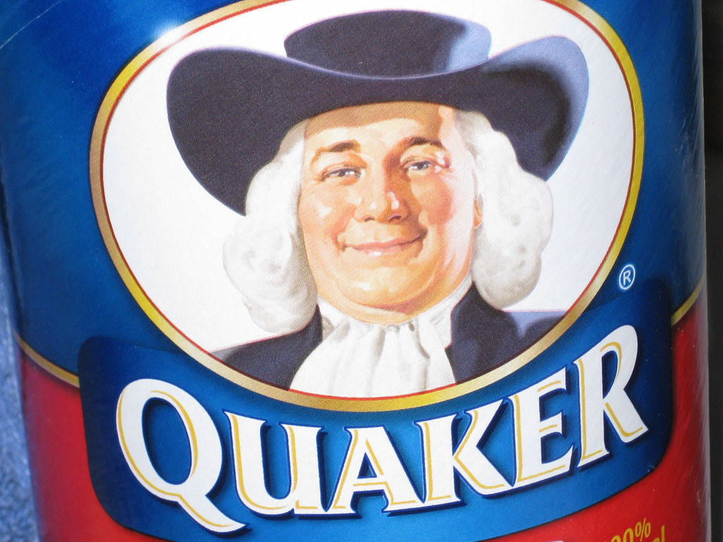
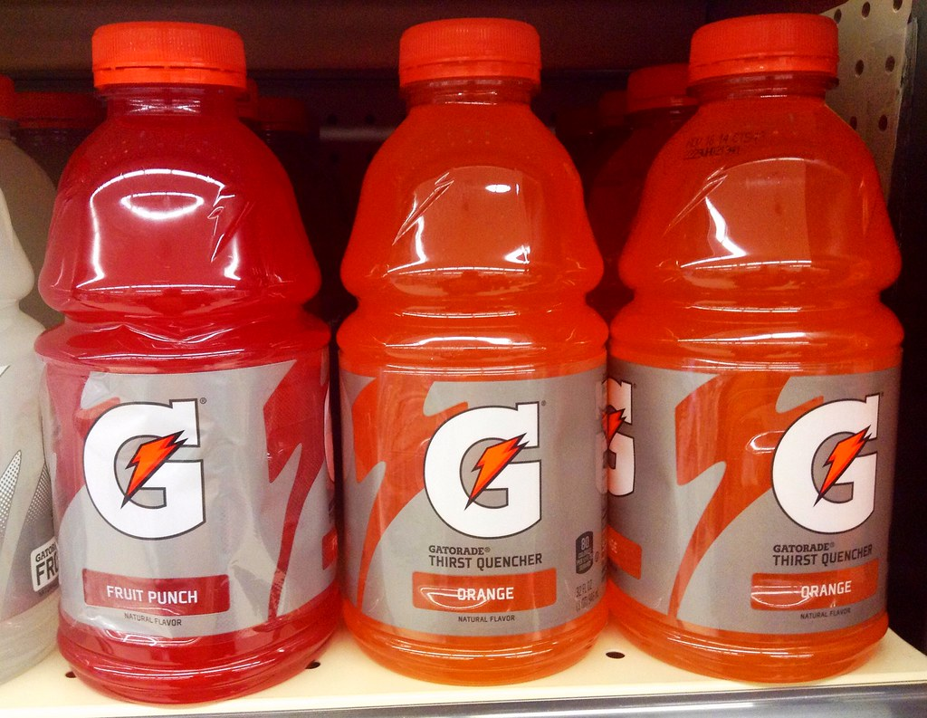
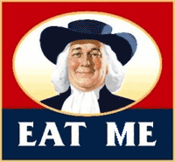
How is the EVA of Coca-Cola and Pepsi compared from a historical point of view?
It was unclear whether Coca-Cola would continue to outperform PepsiCo in terms of EVA in the next few years.
Coca-Cola consistently outperformed PepsiCo in terms of EVA from 1993 to 1998. Coca-Cola faced challenges in the early 2000s, such as the Asian financial crisis, South America's difficulties, and Russia's devaluation of the ruble.
Business mistakes by Doug Ivester, CEO from 1997 to 1999, resulted in a 41% decrease in net income for Coca-Cola.
PepsiCo had strong brands in the noncarbonated-beverage segment such as Aquafina, Tropicana, and Lipton. PepsiCo gained control of 83.6% of the sports drink market by acquiring Quaker Oats, including Gatorade.
After the Gatorade acquisition, analysts estimated that PepsiCo would control around 33% of the U.S. noncarbonated-beverage market, far ahead of Coca-Cola's 21%.

Slide 19
Is the historic trend reversed for Pepsi? What company is the best investment based on the EVA analysis?
Coca-Cola and Pepsi have positive EVA values over three years, indicating that they are creating value for their shareholders.
Coca-Cola's EVA was consistently higher than Pepsi's over the three years.
Pepsi's EVA increased over the three years, indicating better performance.
Coca-Cola's ROIC-WACC spread was 15.5%, 17.6%, and 18.8%, while Pepsi's was 14.1%, 14.6%, and 15.9% for 2001, 2002, and 2003, respectively.
Coca-Cola's EVA values for 2001, 2002, and 2003 were $2,608 million, $3,073 million, and $3,365 million, respectively.
Pepsi's EVA values for 2001, 2002, and 2003 were $2,240 million, $2,565 million, and $2,791 million, respectively.
Other factors such as market trends, competition, and management should also be considered when making investment decisions.

Slide 20
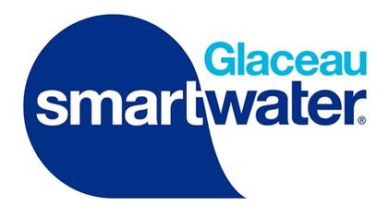
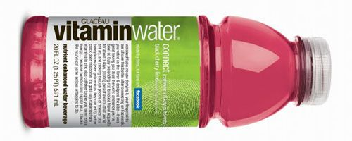
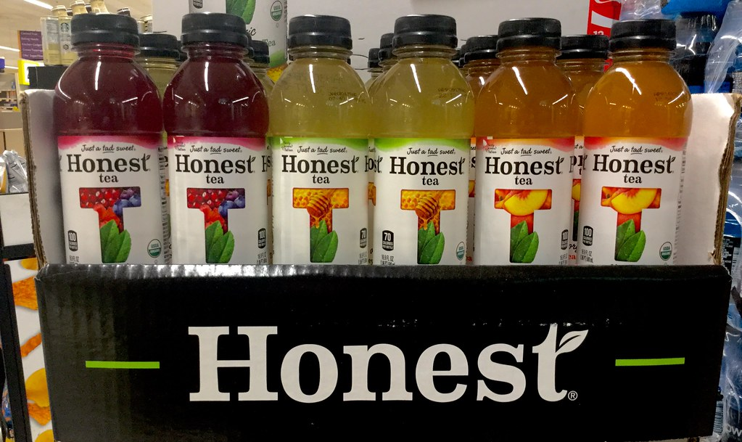
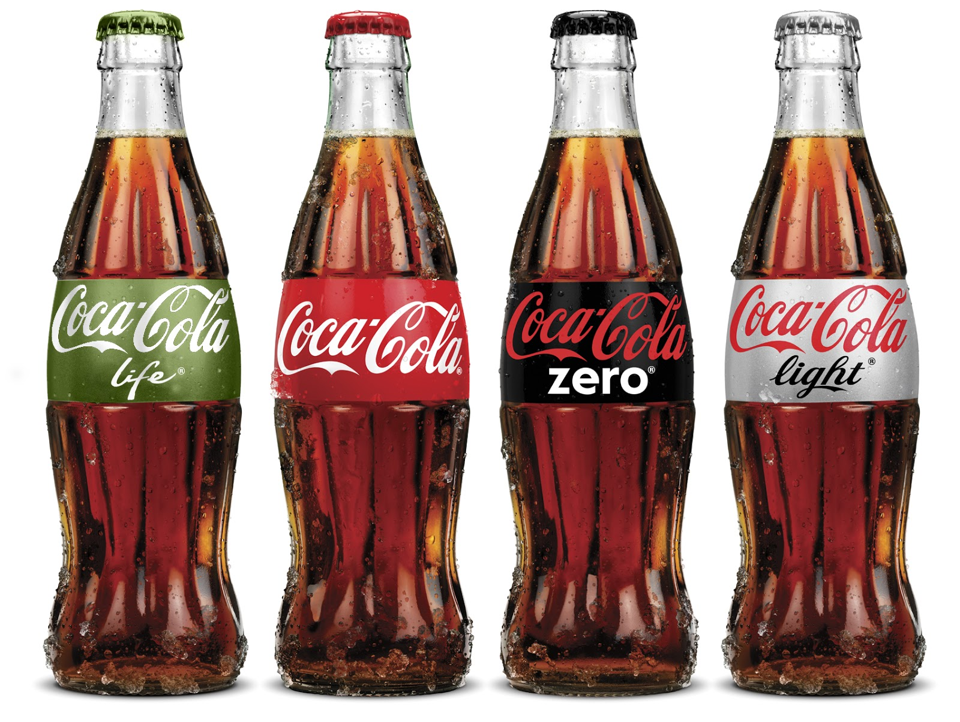
Information about other acquisitions for Coke in the late 2000s and early 2010s
In 2007, Coca-Cola acquired Energy Brands Inc. (Glaceau) for $4.1 billion, which brought popular brands such as Vitaminwater and Smartwater into Coca-Cola's portfolio. In 2008, Coca-Cola acquired a 40% stake in Honest Tea, a maker of organic teas and juices, giving them access to the growing health and wellness market.
In 2010, Coca-Cola acquired Coca-Cola Enterprises Inc.'s North American bottling business for $12.3 billion, which allowed them to streamline their bottling operations and take more control over distribution.
Also in 2010, Coca-Cola acquired the Mexican bottled water brand Ciel, helping them expand their presence in the growing Latin American market.
In 2009, Coca-Cola attempted to acquire China Huiyuan Juice Group Limited for $2.4 billion, but the deal was blocked by the Chinese government due to concerns about market competition. Overall, these acquisitions helped Coca-Cola diversify its product offerings and expand its presence in key markets.

